Slide 1
Fraud Detection
Report : Models with both features kept during FE & EDA

Slide 2
Features & their correlation
‘Fraud_label’ is our target feature for the dataset, and the two features mentioned here are the most correlated features to the target feature.
In this version of the report, I kept both the features after doing the FE & EDA.
After, that I used the different Machine Learning models as well as Deep Learning model ANN.
For tree-based models, I didn’t apply any scaling method.
For Distance based models, I used the Min Max scaler.
Fraud_Label 1.000000
Failed_Transaction_Count_7d 0.509871
Risk_Score 0.385810

Slide 3
Distance Based Algorithms
Logistic Regression
SVC
KNN
Accuracy score : 0.80264
Confusion matrix :
[[7434 1014]
[1453 2599]]
precision recall f1-score support
0 0.84 0.88 0.86 8448
1 0.72 0.64 0.68 4052
accuracy 0.80 12500
macro avg 0.78 0.76 0.77 12500
weighted avg 0.80 0.80 0.80 12500
Accuracy score : 0.77632
Confusion matrix :
[[8448 0]
[2796 1256]]
precision recall f1-score support
0 0.75 1.00 0.86 8448
1 1.00 0.31 0.47 4052
accuracy 0.78 12500
macro avg 0.88 0.65 0.67 12500
weighted avg 0.83 0.78 0.73 12500
Accuracy score : 0.81616
Confusion matrix :
[[7870 578]
[1720 2332]]
precision recall f1-score support
0 0.82 0.93 0.87 8448
1 0.80 0.58 0.67 4052
accuracy 0.82 12500
macro avg 0.81 0.75 0.77 12500
weighted avg 0.81 0.82 0.81 12500

Slide 4
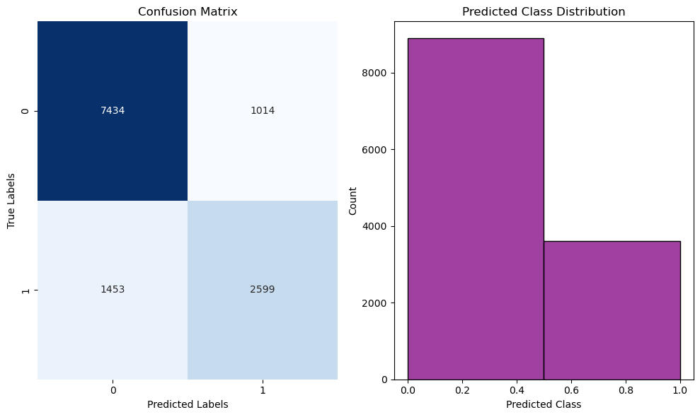
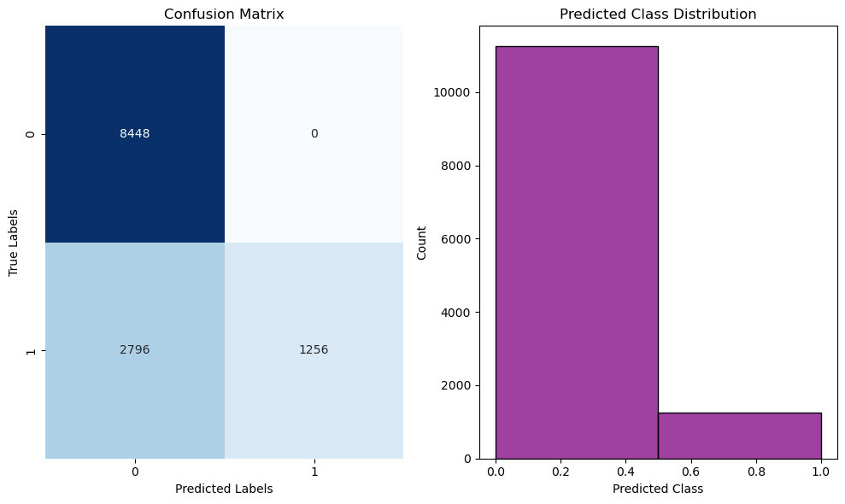
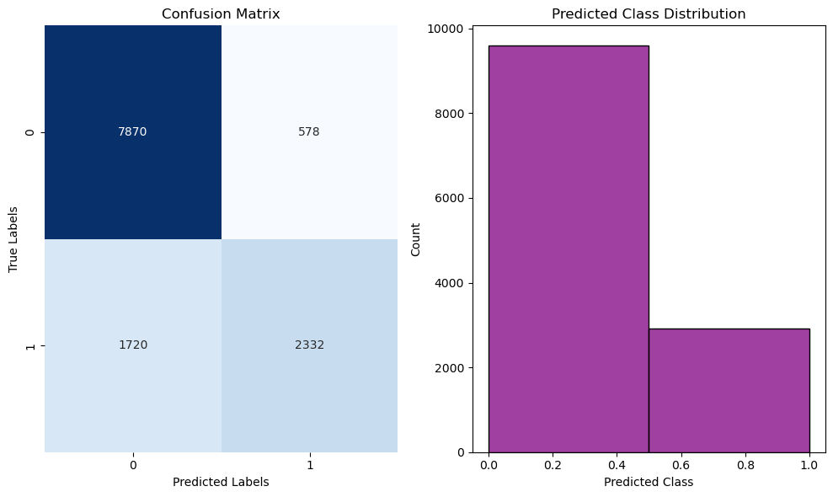
Graphs
Logistic Regression
SVC
KNN

Slide 5
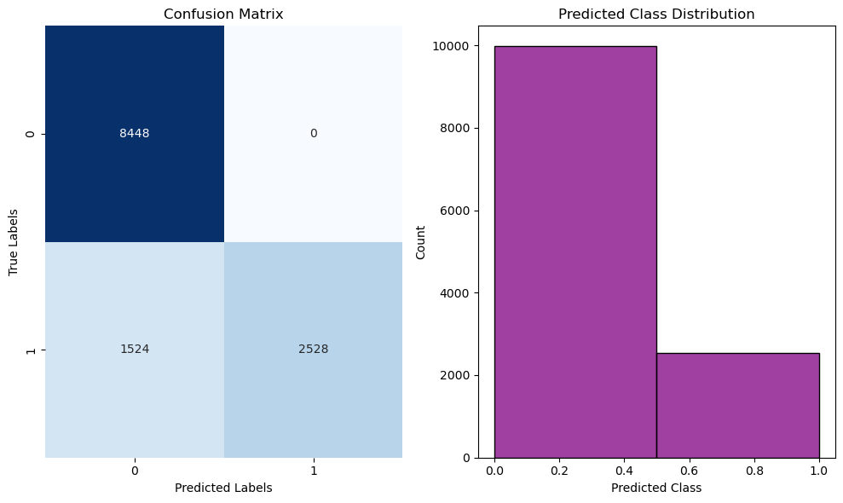
Probability based Algorithm(NB)
Accuracy score : 0.87808
Confusion matrix :
[[8448 0]
[1524 2528]]
precision recall f1-score support
0 0.85 1.00 0.92 8448
1 1.00 0.62 0.77 4052
accuracy 0.88 12500
macro avg 0.92 0.81 0.84 12500
weighted avg 0.90 0.88 0.87 12500

Slide 6
Tree Based Algorithms
Decision Tree
Random Forest
Adaboost
Accuracy score : 1.0
Confusion matrix :
[[8448 0]
[ 0 4052]]
precision recall f1-score support
0 1.00 1.00 1.00 8448
1 1.00 1.00 1.00 4052
accuracy 1.00 12500
macro avg 1.00 1.00 1.00 12500
weighted avg 1.00 1.00 1.00 12500
Accuracy score : 1.0
Confusion matrix :
[[8448 0]
[ 0 4052]]
precision recall f1-score support
0 1.00 1.00 1.00 8448
1 1.00 1.00 1.00 4052
accuracy 1.00 12500
macro avg 1.00 1.00 1.00 12500
weighted avg 1.00 1.00 1.00 12500
Accuracy score : 1.0
Confusion matrix :
[[8448 0]
[ 0 4052]]
precision recall f1-score support
0 1.00 1.00 1.00 8448
1 1.00 1.00 1.00 4052
accuracy 1.00 12500
macro avg 1.00 1.00 1.00 12500
weighted avg 1.00 1.00 1.00 12500

Slide 7
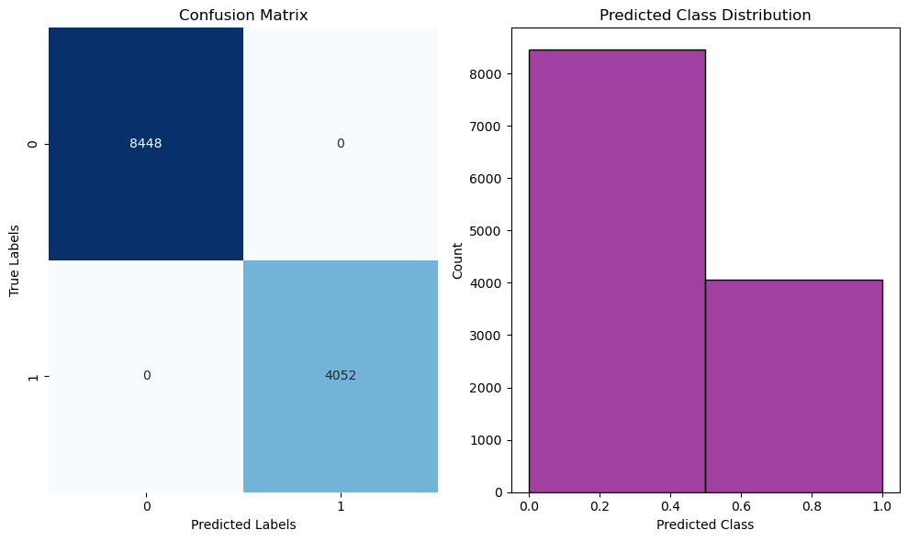
Graphs
Decision Tree
Random Forest
Adaboost

Slide 8
Gradient boost (Tree based)
Accuracy score : 1.0
Confusion matrix :
[[8448 0]
[ 0 4052]]
precision recall f1-score support
0 1.00 1.00 1.00 8448
1 1.00 1.00 1.00 4052
accuracy 1.00 12500
macro avg 1.00 1.00 1.00 12500
weighted avg 1.00 1.00 1.00 12500

Slide 9
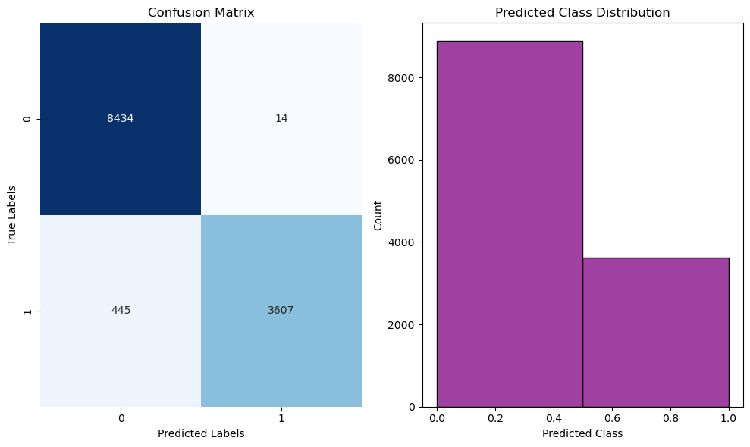
ANN(Deep learning model)
Accuracy score : 0.96328
Confusion matrix :
[[8434 14]
[ 445 3607]]
precision recall f1-score support
0 0.95 1.00 0.97 8448
1 1.00 0.89 0.94 4052
accuracy 0.96 12500
macro avg 0.97 0.94 0.96 12500
weighted avg 0.96 0.96 0.96 12500

